Slide 1
Training
neural networks
Florin Gogianu
Bitdefender ML team
* using slides, illustrations and ideas from prof. Simon Prince UDLB, Stanford CS231n, LeCun, Canziani, NYU Deep Learning

Slide 2
Reading
Lecture 1: chapters 1, 2, 8.1-3, 9.1, Prince, Understanding Deep Learning
Lecture 2: chapters 3 and 4, UDL. LeCun, Bengio, Hinton, Deep Learning (paper)
Lecture 3:
chapters 5, 6 and 7, UDL.
Goh, Why Momentum Really Works?

Slide 3
Recap
?

Slide 4
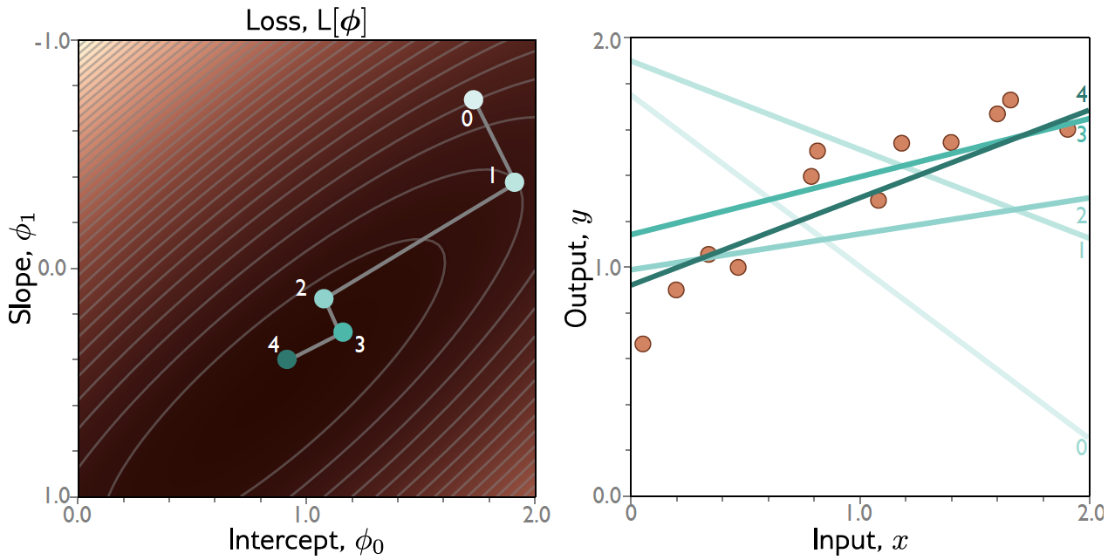
Training a simple model
Define a loss function
Compute the change in parameters required to make the loss smaller
Apply the change and get new parameters
Repeat from (2)

Slide 5
Loss functions

Slide 6
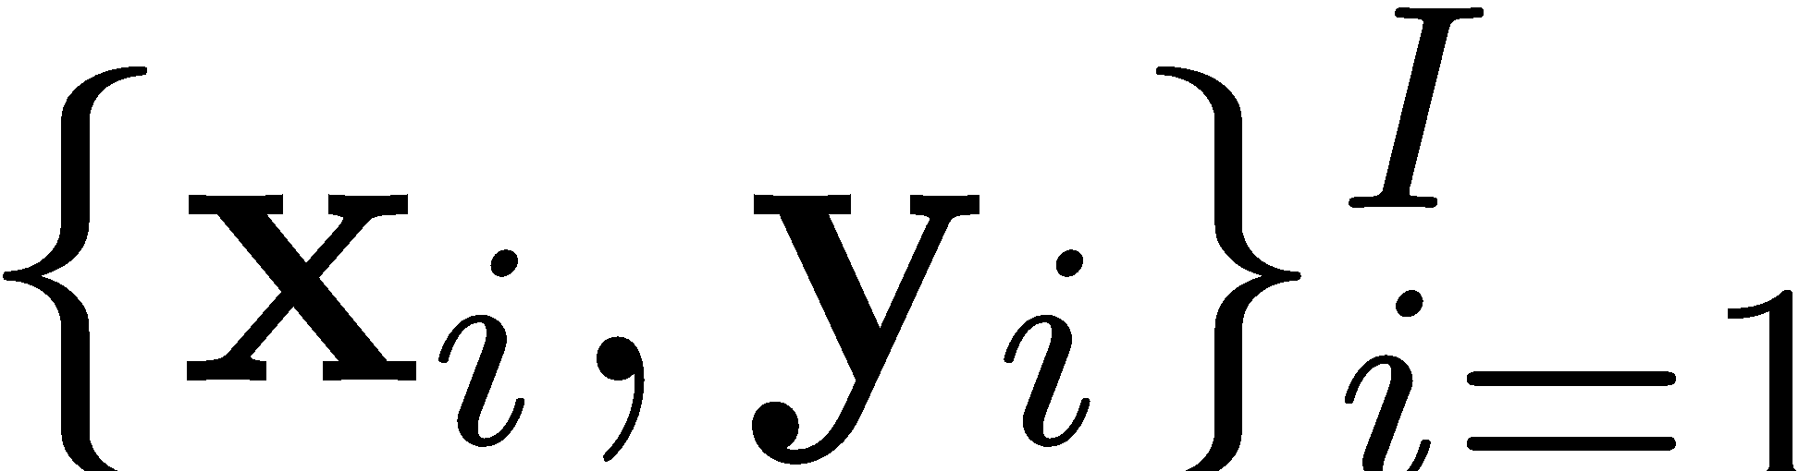
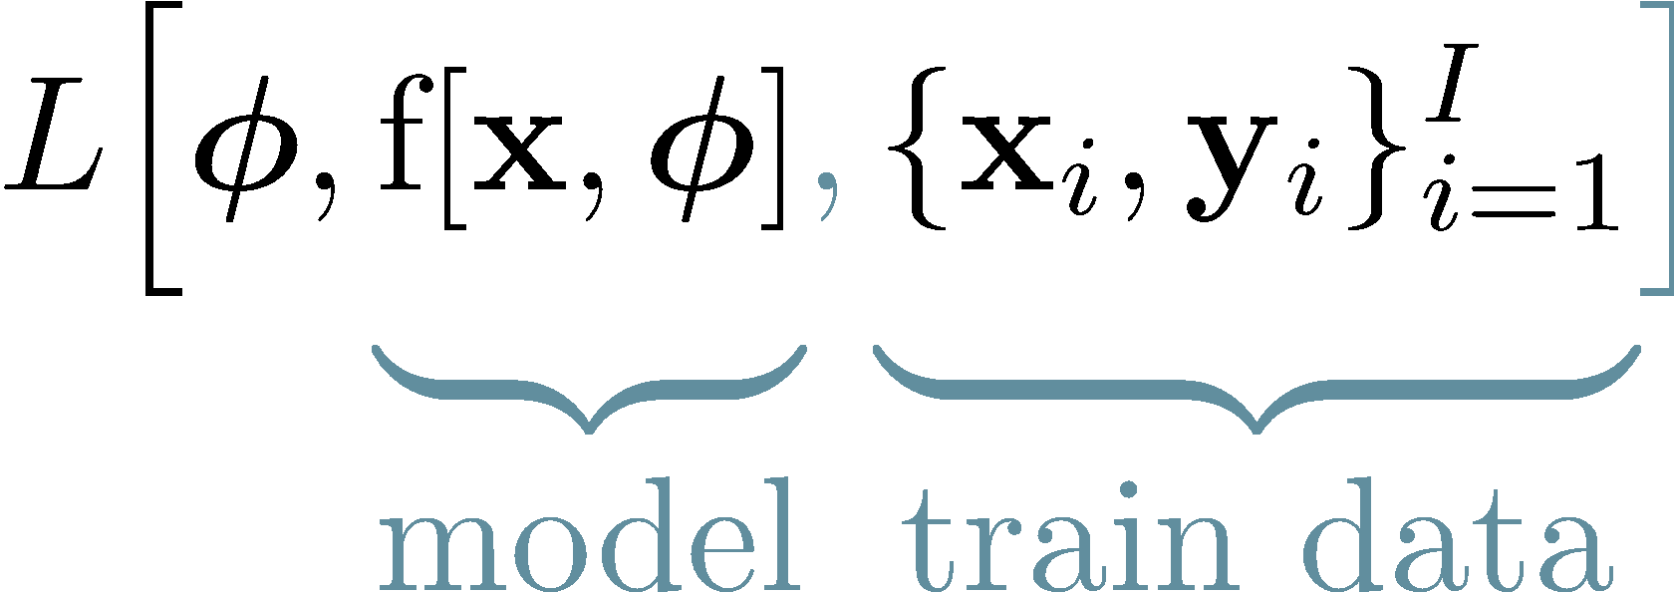
Loss function
Training dataset of I pairs of input/output examples:
Loss function or cost function measures how bad model is:

Slide 7
Loss function
Training dataset of I pairs of input/output examples:
Loss function or cost function measures how bad model is:
L[𝜙]
Returns a scalar that is smaller when model maps inputs to outputs better

Slide 8
Loss function as an optimization objective
Find the parameters that minimize the loss:
𝜙 = argmin_{𝜙} [ L(𝜙) ]

Slide 9
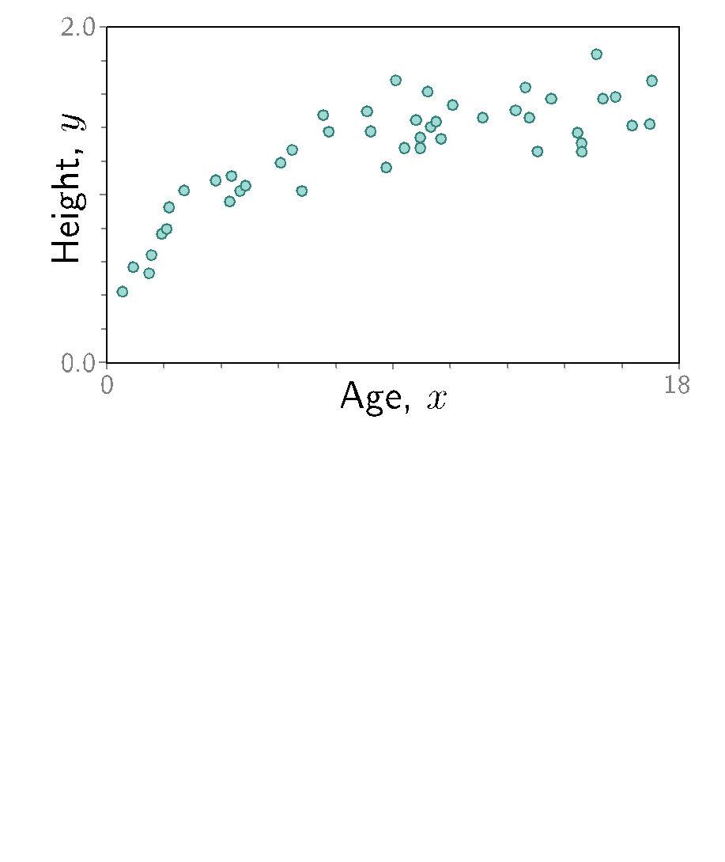

Slide 10
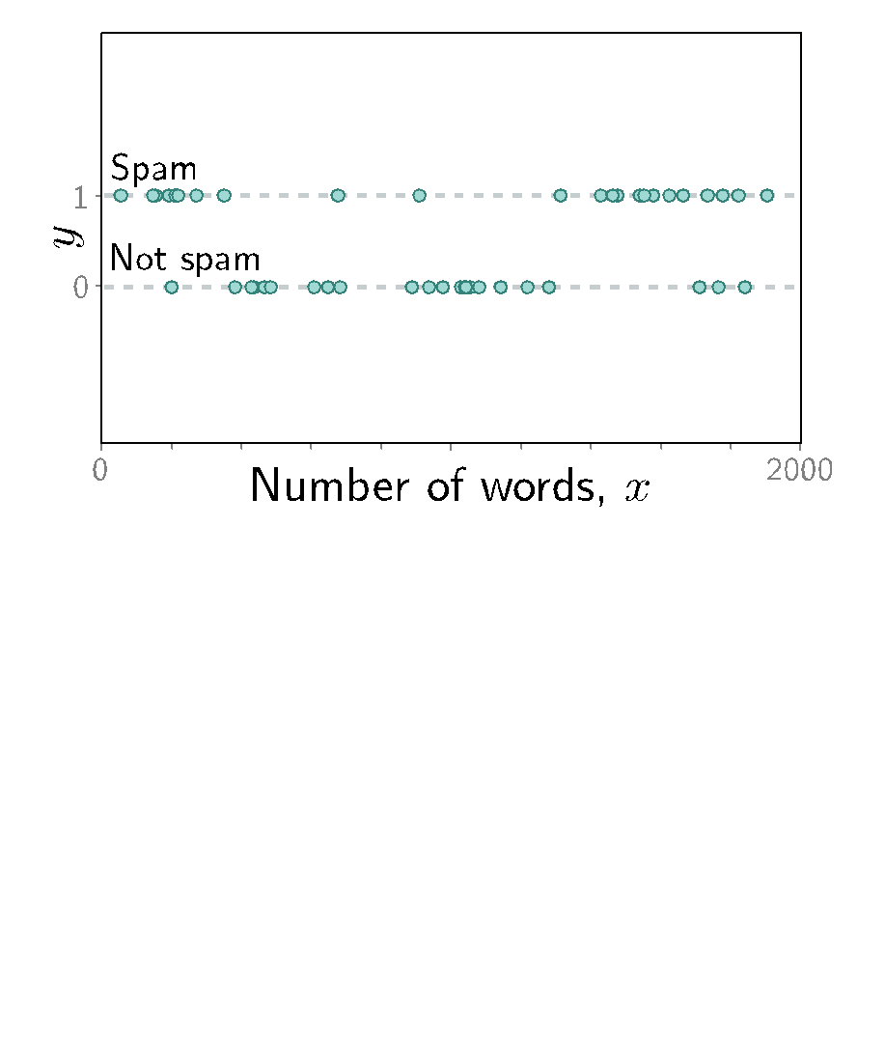

Slide 11
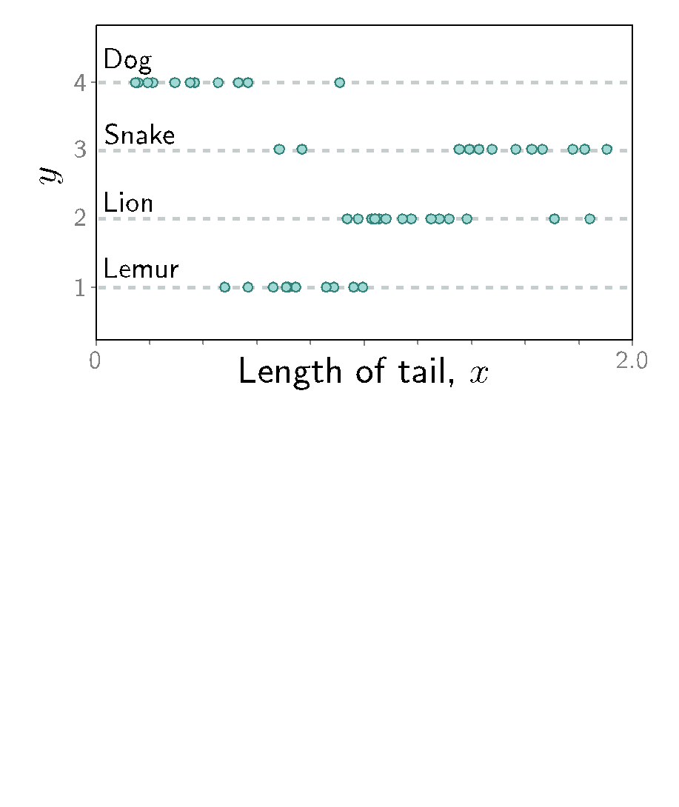

Slide 12
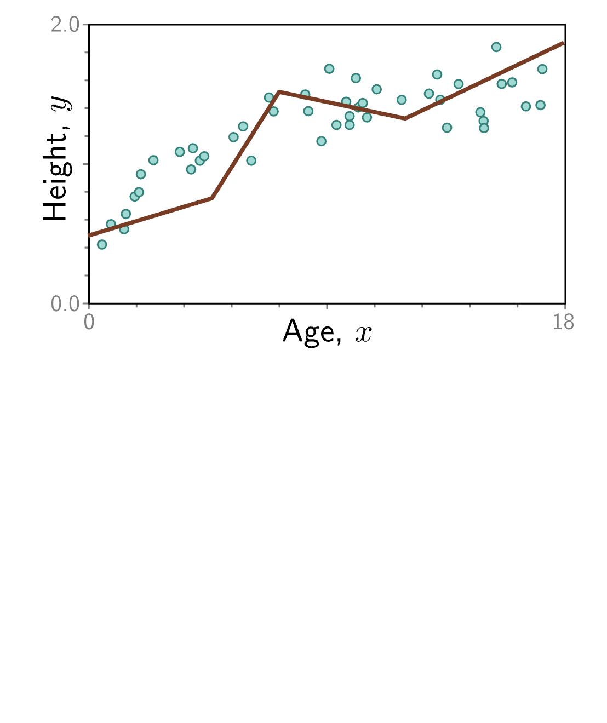
What do we mean, probabilistically,
about fitting y = f(x)?
?

Slide 13
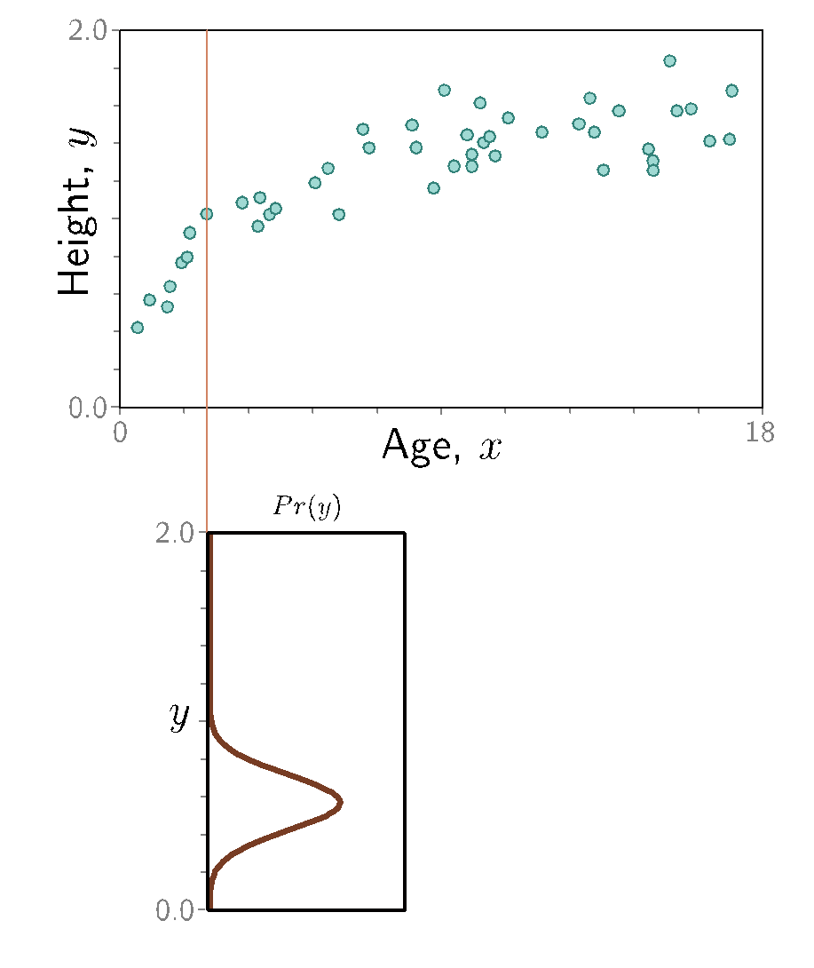

Slide 14
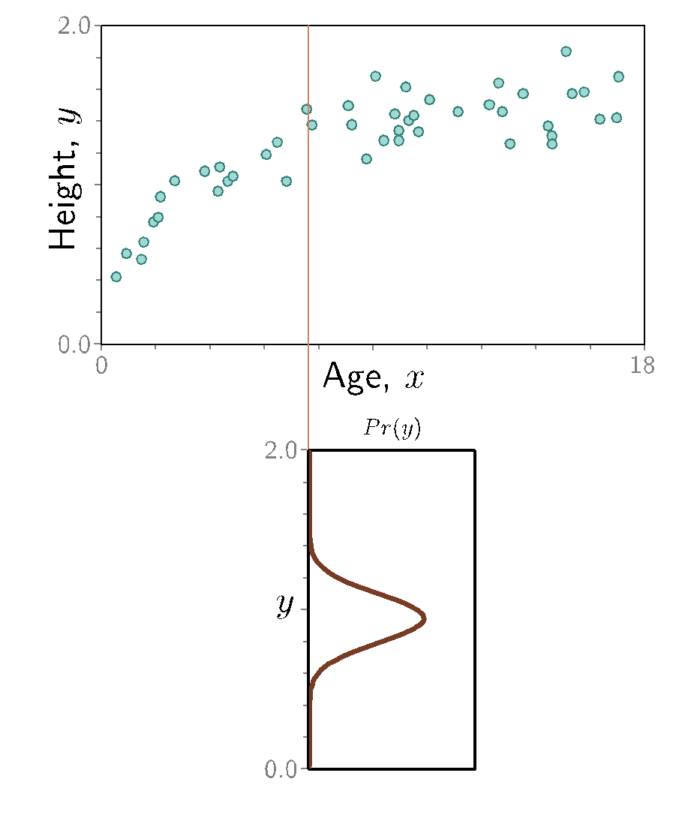

Slide 15
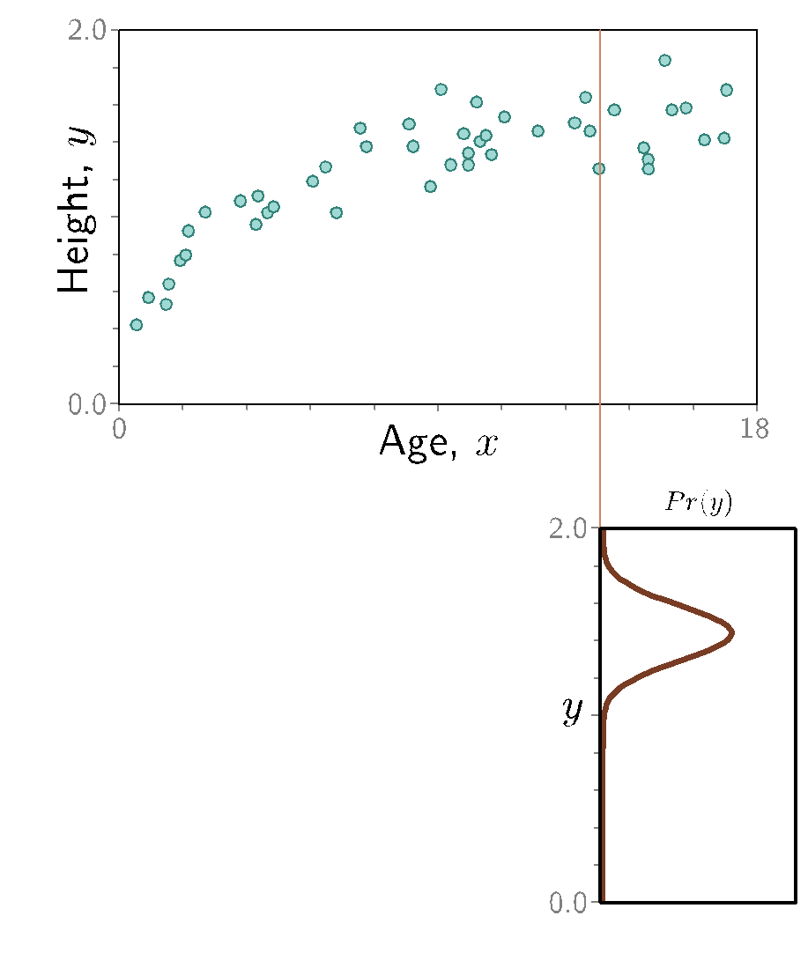

Slide 17
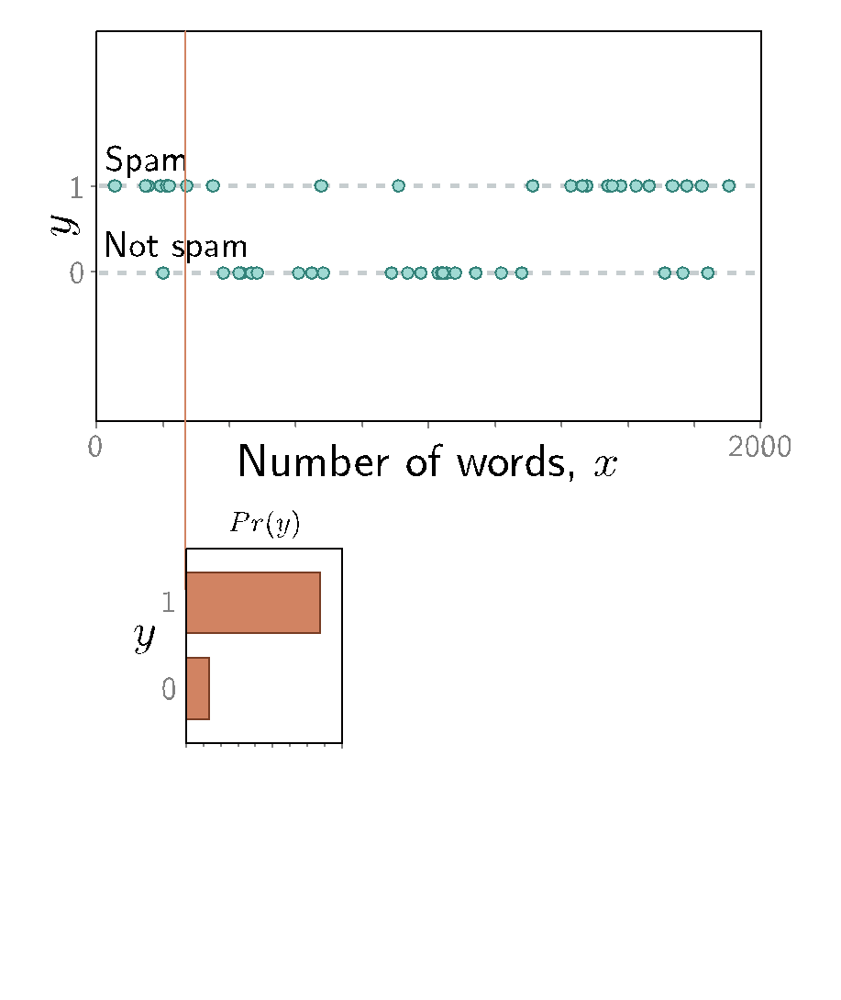

Slide 18
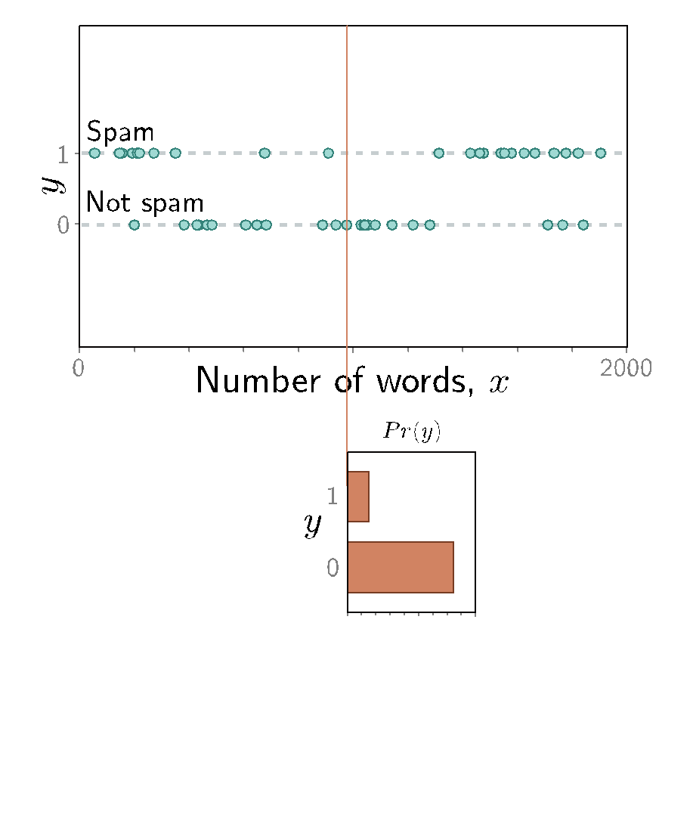

Slide 19
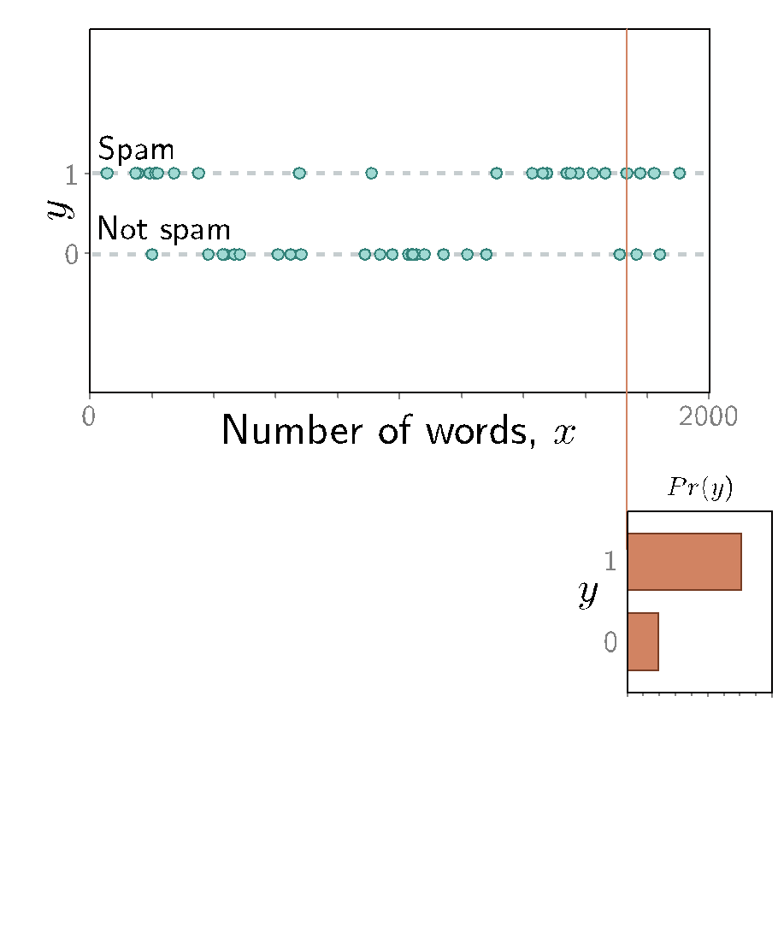

Slide 21
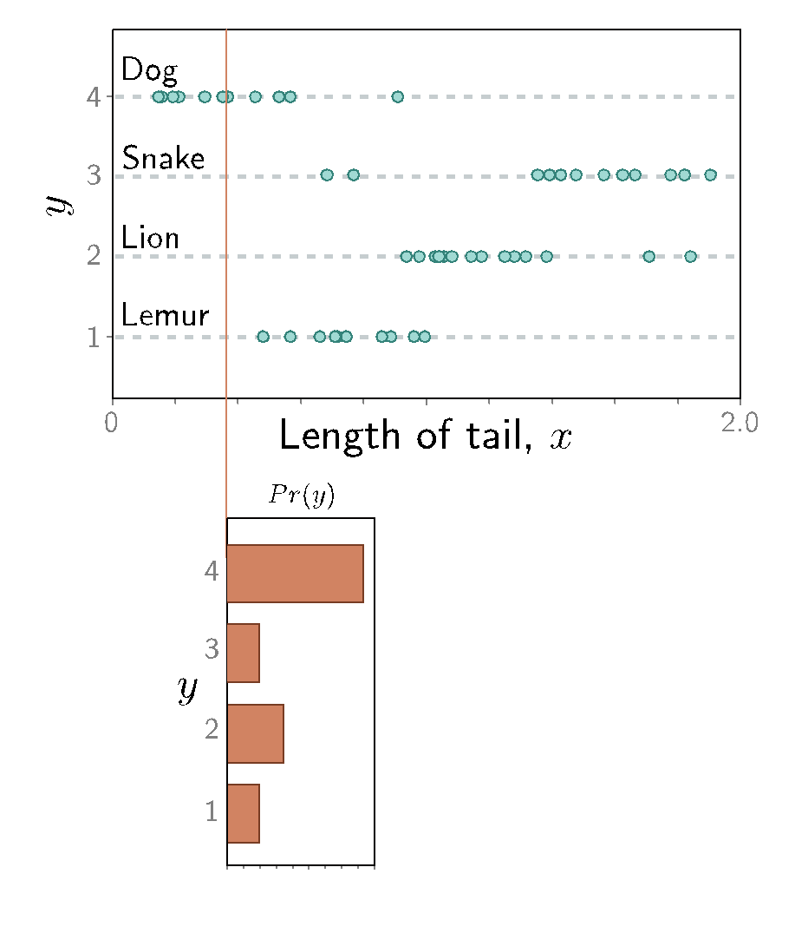

Slide 22
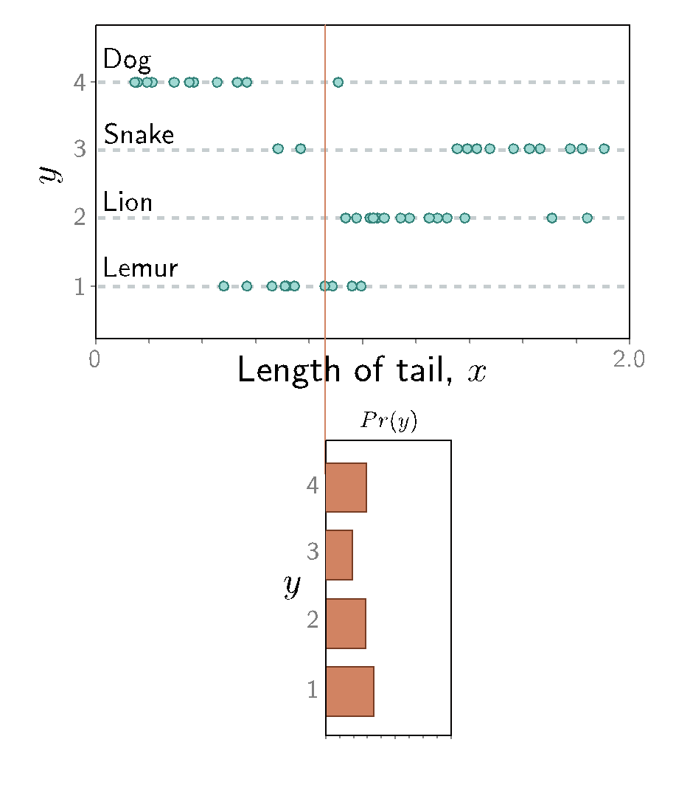

Slide 23
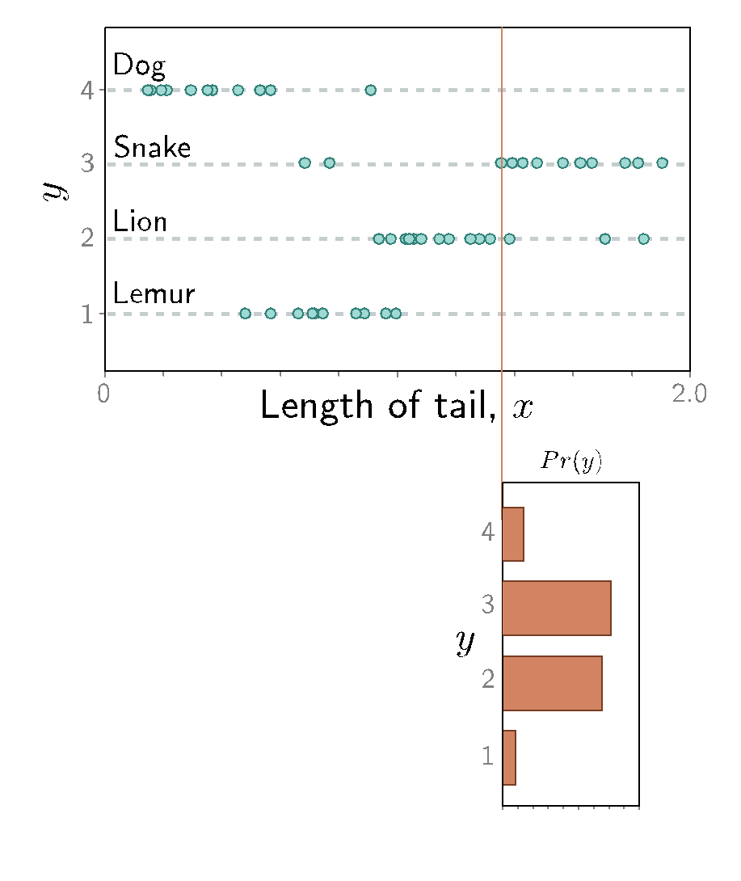

Slide 24
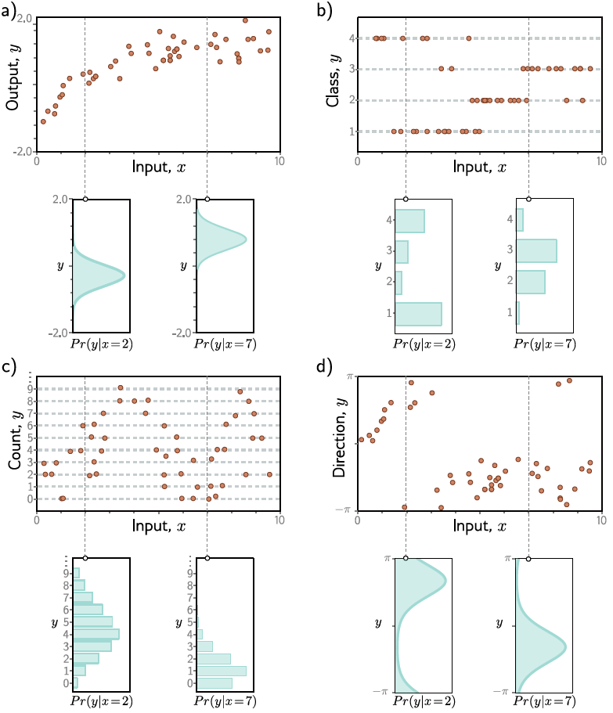

Slide 25
Encourage each prediction (model output) y_{i}
to have high probability conditioned on (model input) x_{i}

Slide 26
A general recipe for constructing loss functions
Model predicts output y given x
Model predicts a conditional probability distribution:
Pr ( y | x )
Loss function aims to make the outputs have high probability unde the conditional distribution

Slide 27
From model output to probability distribution
Pick a known distribution (eg.: Normal) to model output y with with parameters 𝜃 = {𝜇𝜎²}
Pr ( y | x )
Fit the model so that it predicts the parameters 𝜇 and 𝜎 of the distribution.

Slide 28
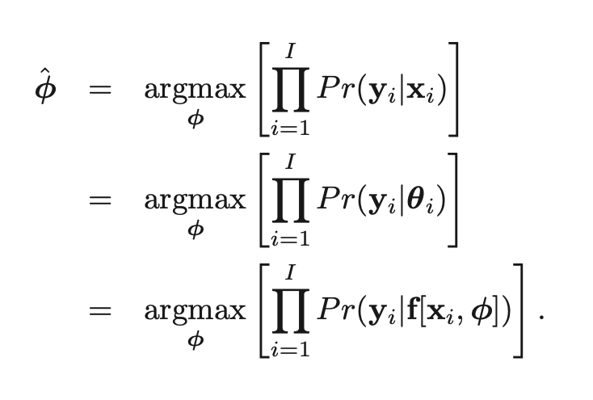
Maximum likelihood criterion
When we consider this probability as a function of the parameters 𝜙, we call it a likelihood.

Slide 29
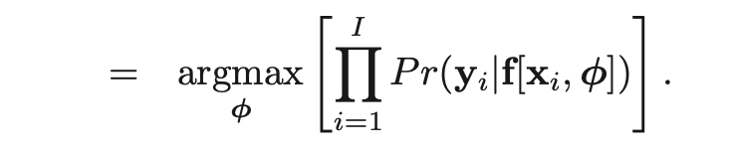
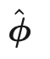
Problem:
The terms in this product might all be small
The product might get so small that we can’t easily represent it

Slide 30
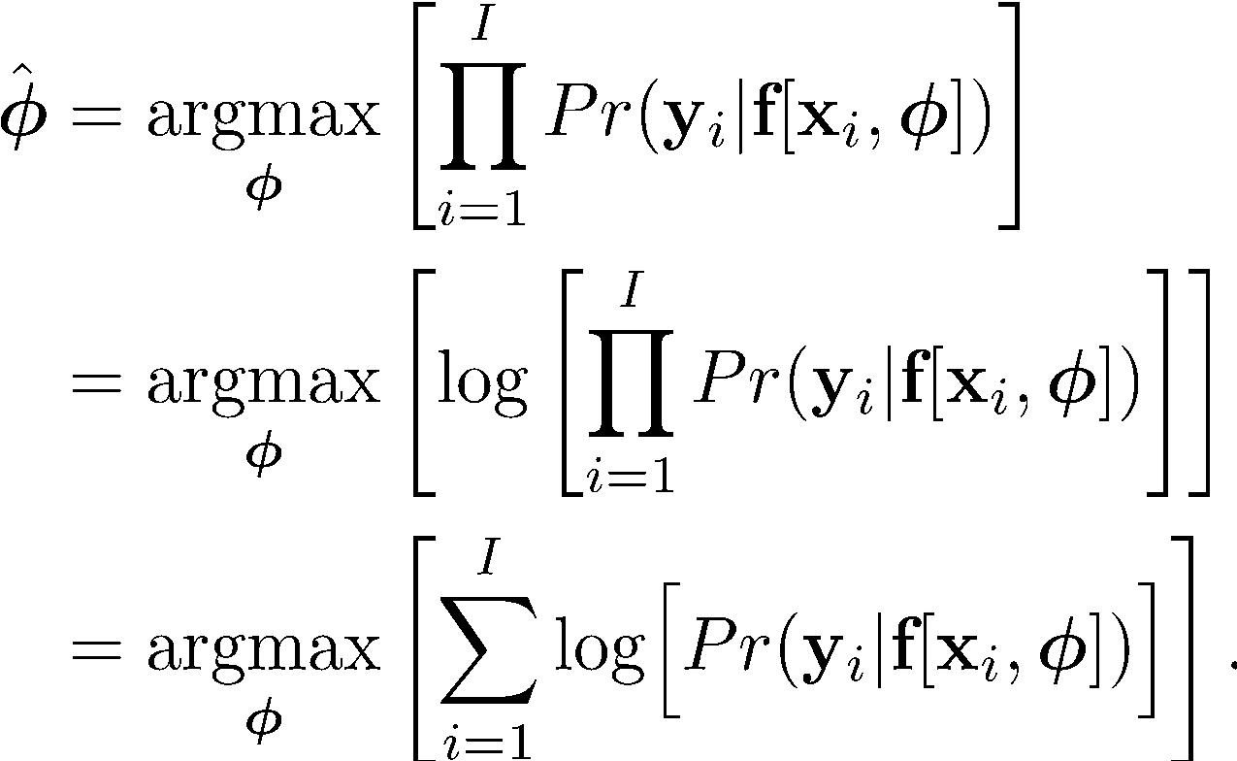
Maximum log likelihood
Now it’s a sum of terms, so doesn’t matter so much if the terms are small

Slide 31
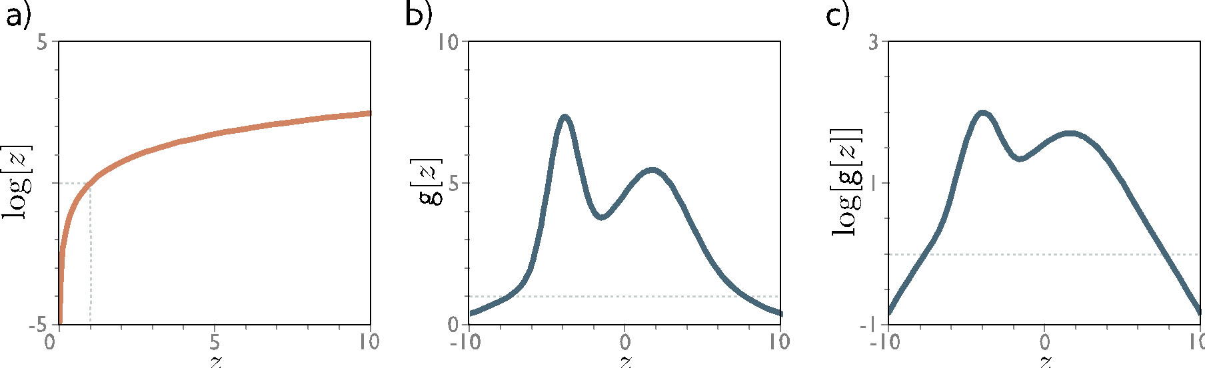
The log function is monotonic
Maximum of the logarithm of a function is in the same place as maximum of function

Slide 32
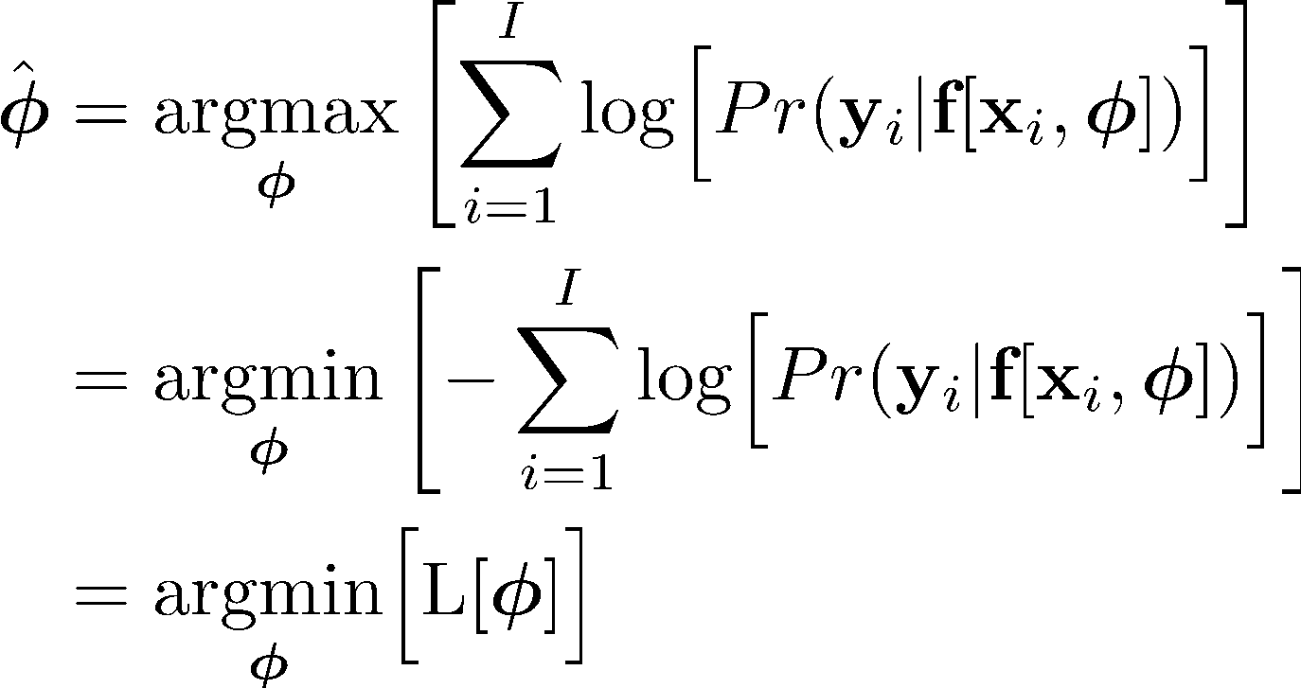
Minimizing negative log likelihood
By convention, we minimize things (i.e., a loss)

Slide 33
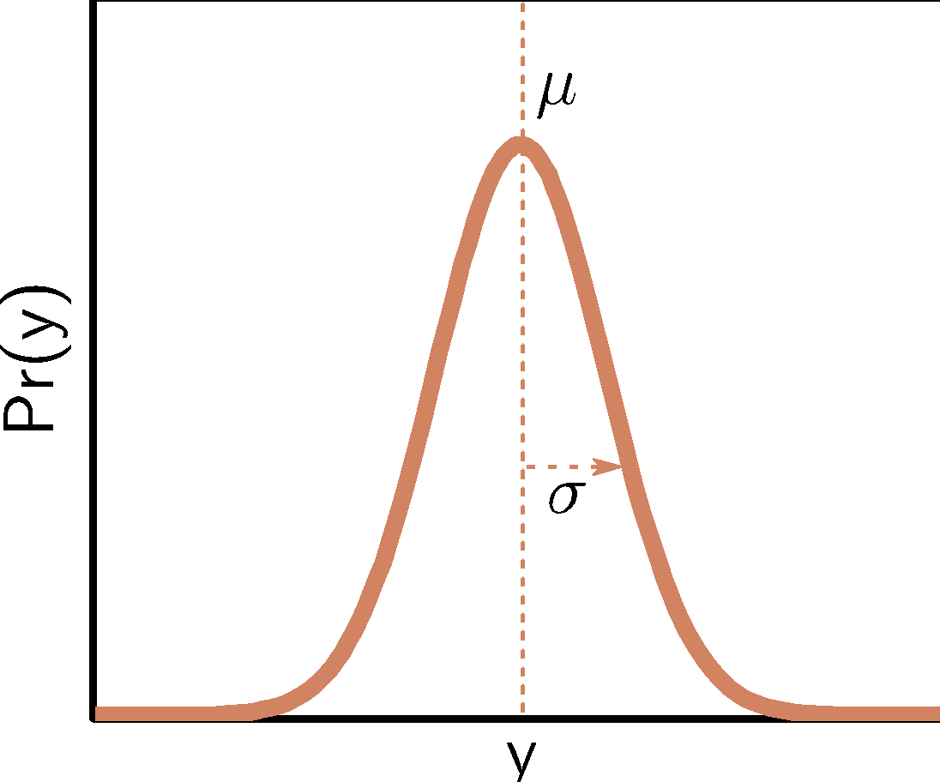
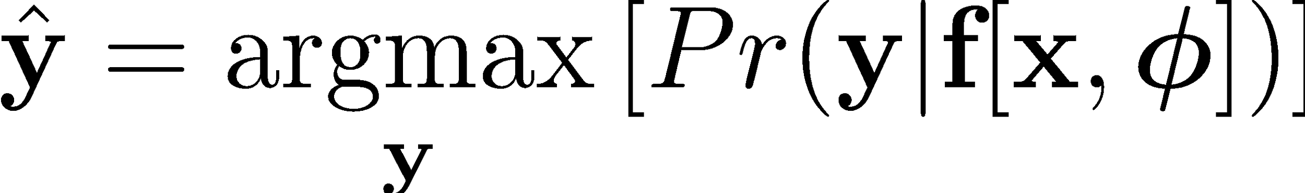
Inference (prediction)
But now we predict a probability distribution
We need an actual prediction (point estimate)
Find the peak of the probability distribution (i.e., mean for normal)

Slide 34
From MLE to common loss functions
Go through 5.3 to 5.5 to convince yourselves that minimizing the negative log likelihood amounts to minimizing:
Mean squared error (univariate regression / Gaussian)
Binary cross-entropy (binary classification / Bernoulli)
Cross-entropy (multiclass classification / Categorical)

Slide 35
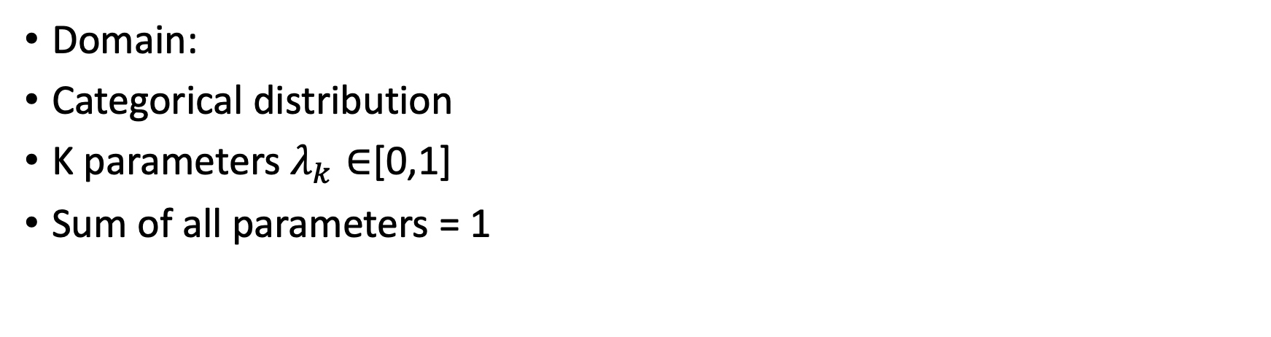
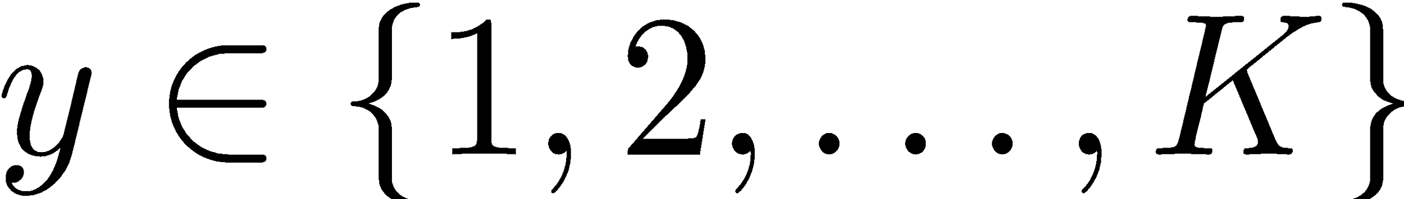
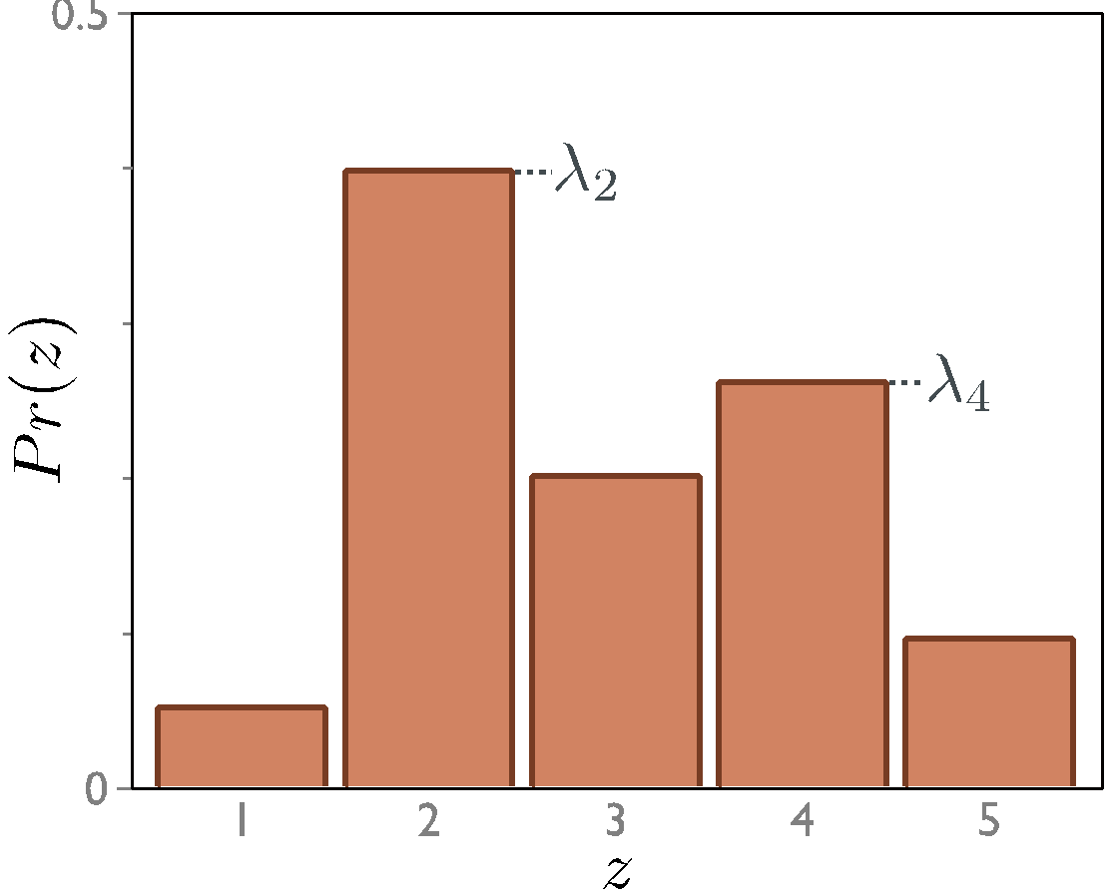
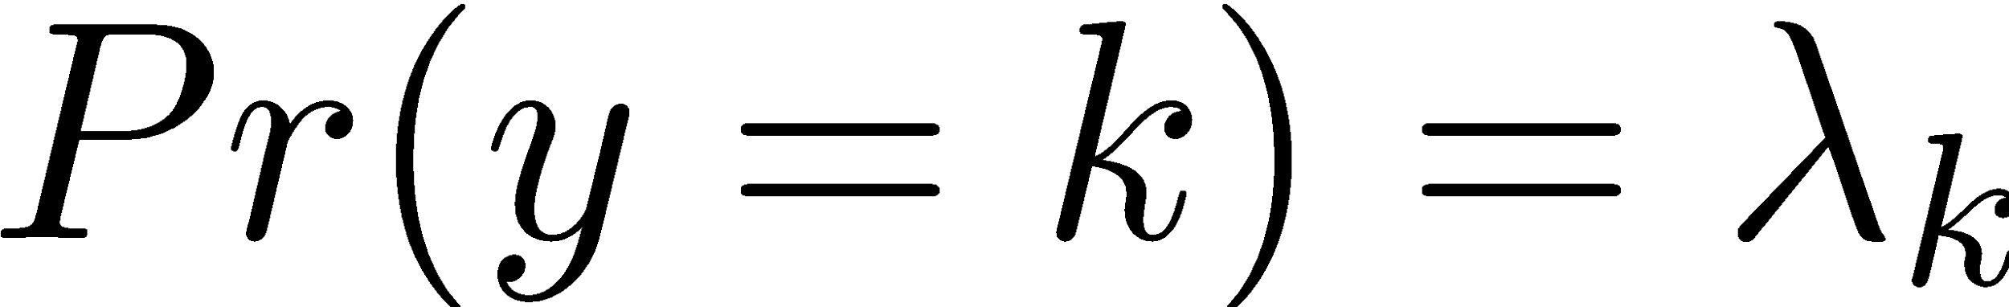
Example: multiclass classification

Slide 36
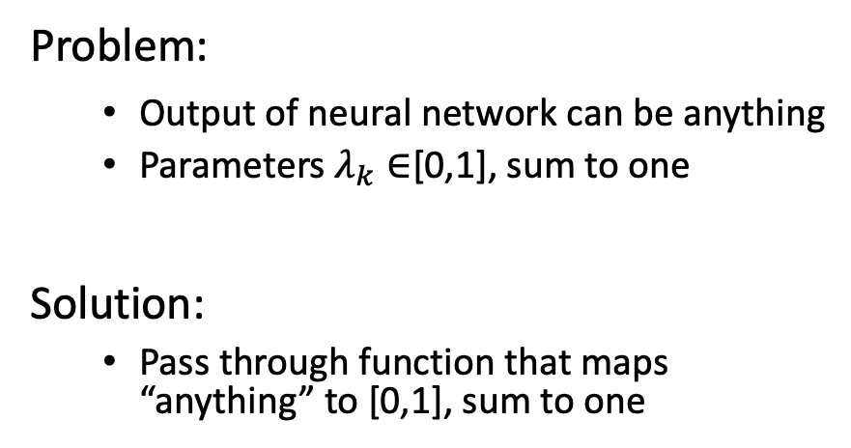
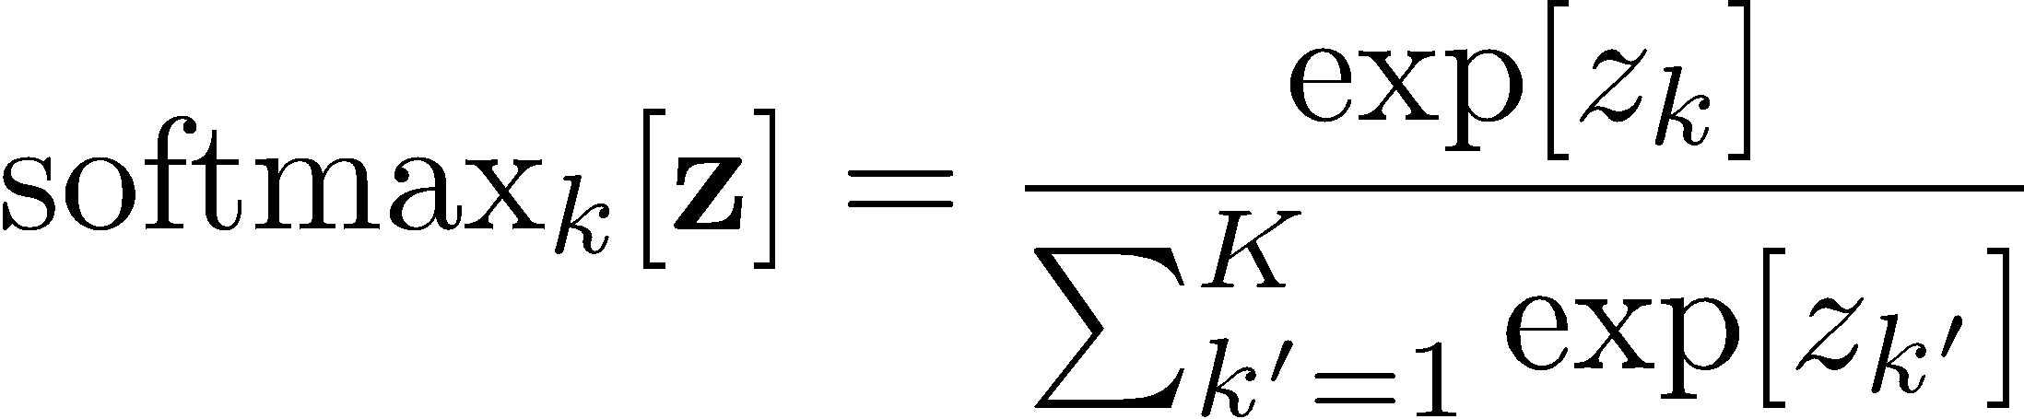
Example: multiclass classification

Slide 37
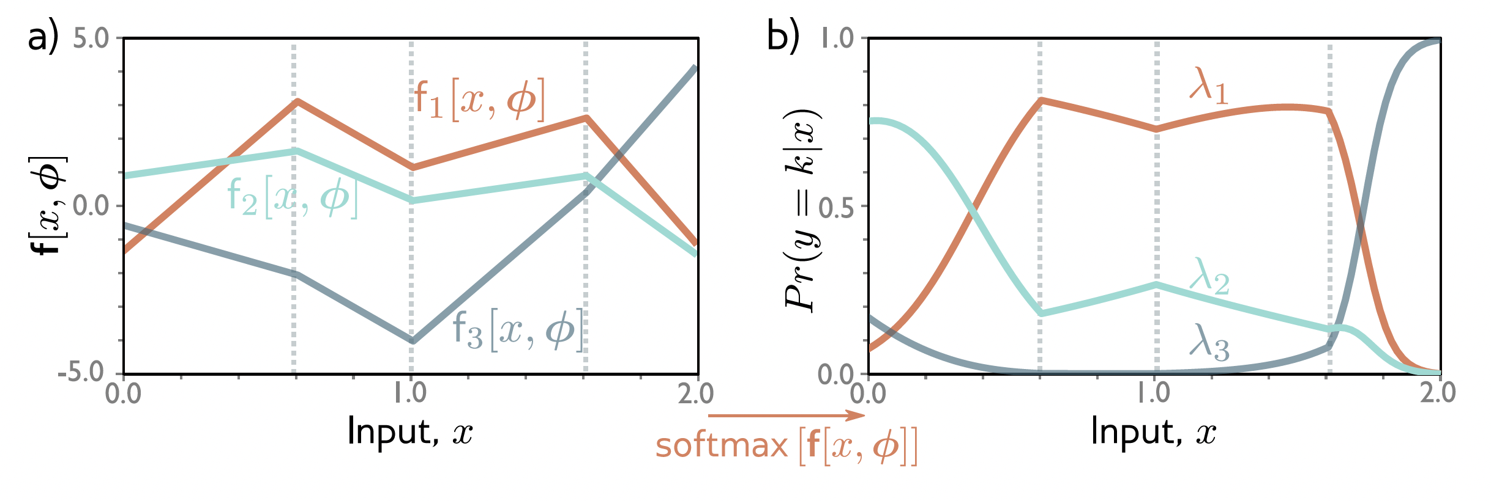
Example: multiclass classification

Slide 38
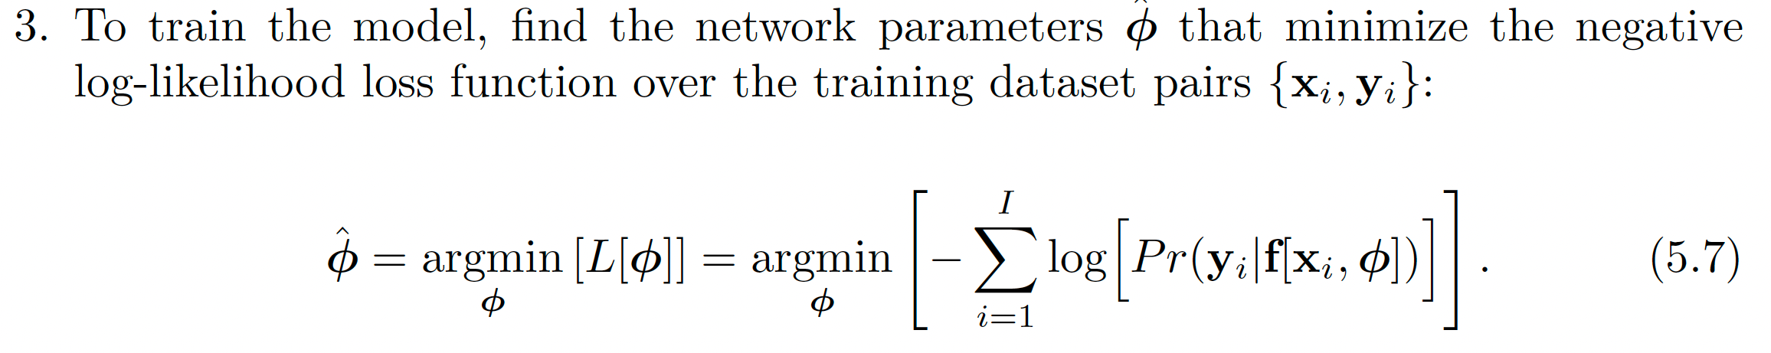
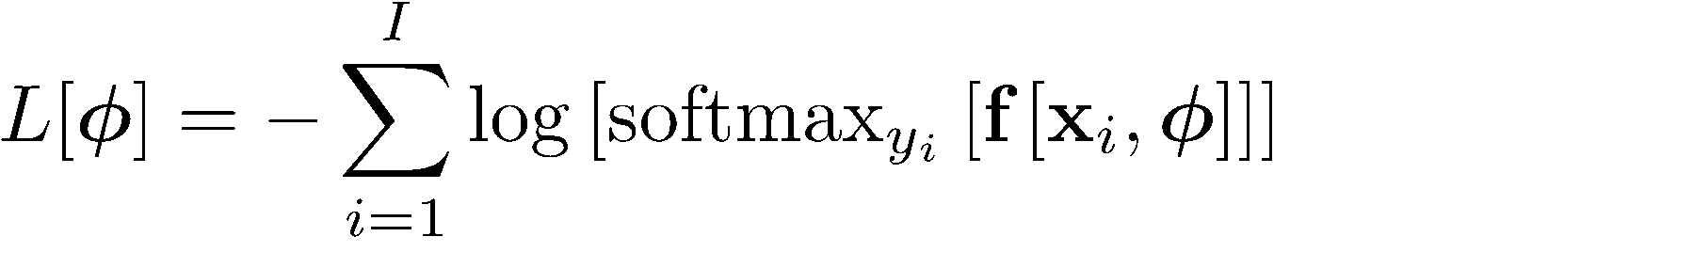
Example: multiclass classification
*Multiclass cross-entropy loss*

Slide 39
Computing gradients

Slide 40
Training a simple model
Define a loss function
Compute the change in parameters required to make the loss smaller
Apply the change and get new parameters
Repeat from (2)

Slide 41
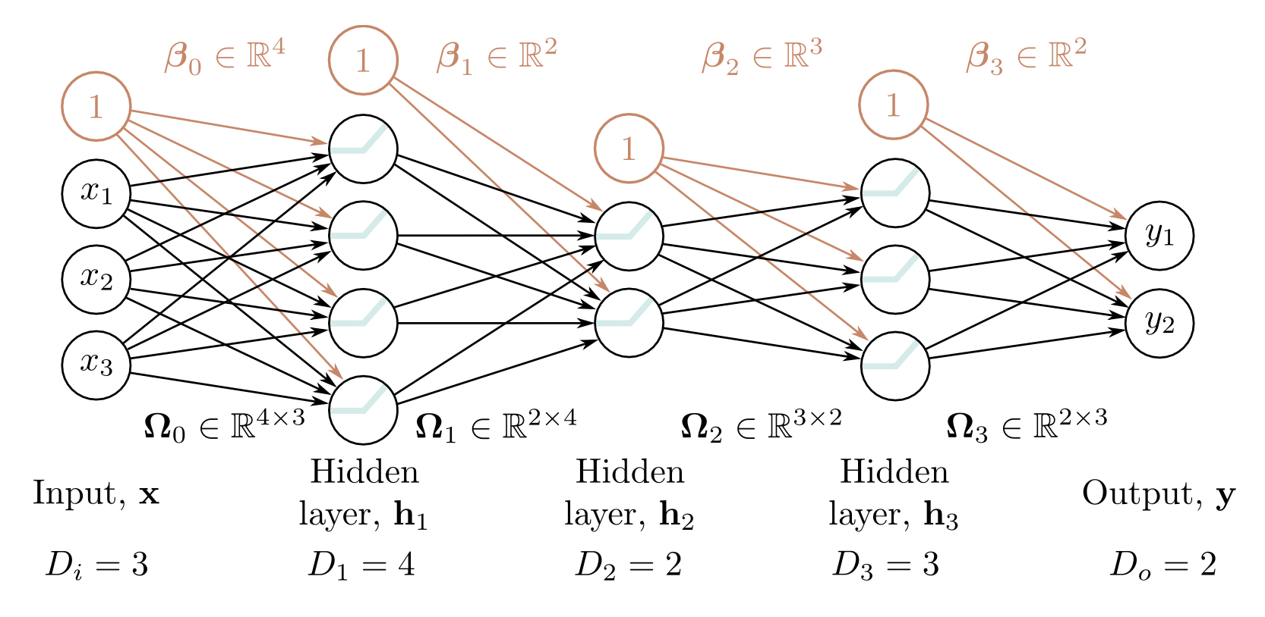
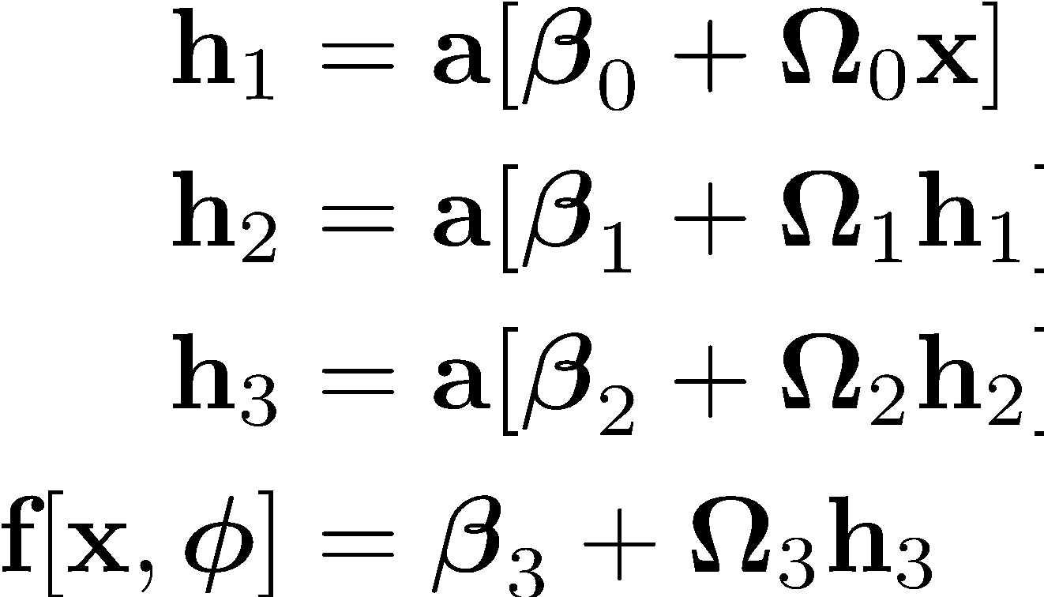
Neural network

Slide 42
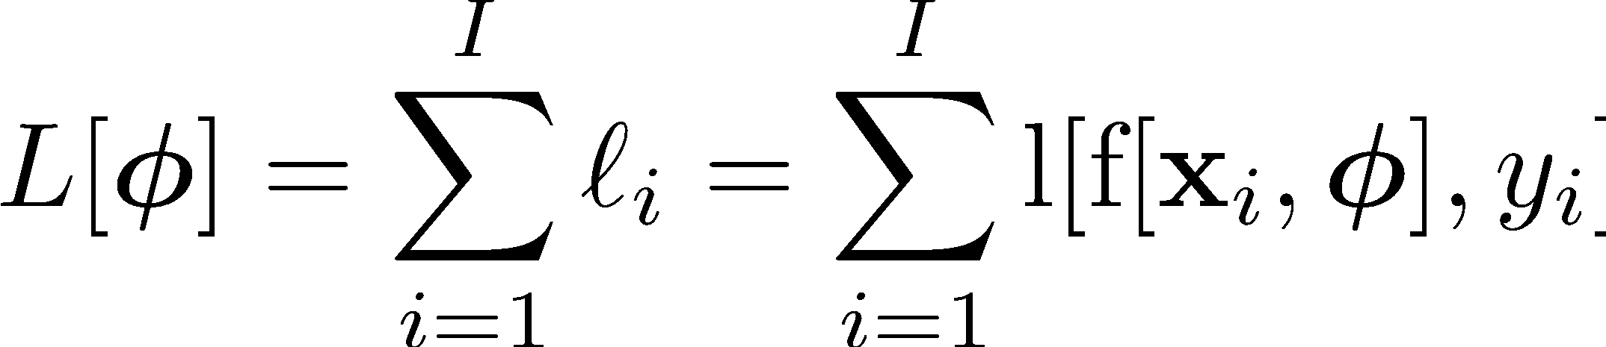
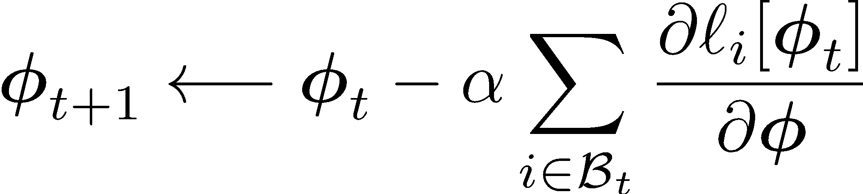
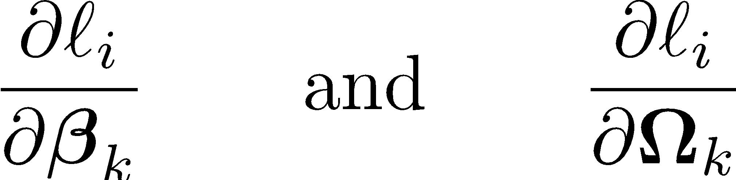
Setup
Loss, sum of individual terms:
SGD algorithm
Parameters
How to compute gradients?

Slide 43
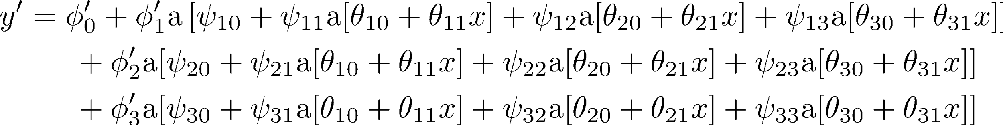
Big deal?
Huge equation, and we need to compute derivatives:
for every parameter
for every point in the batch
for every iteration of SGD

Slide 44
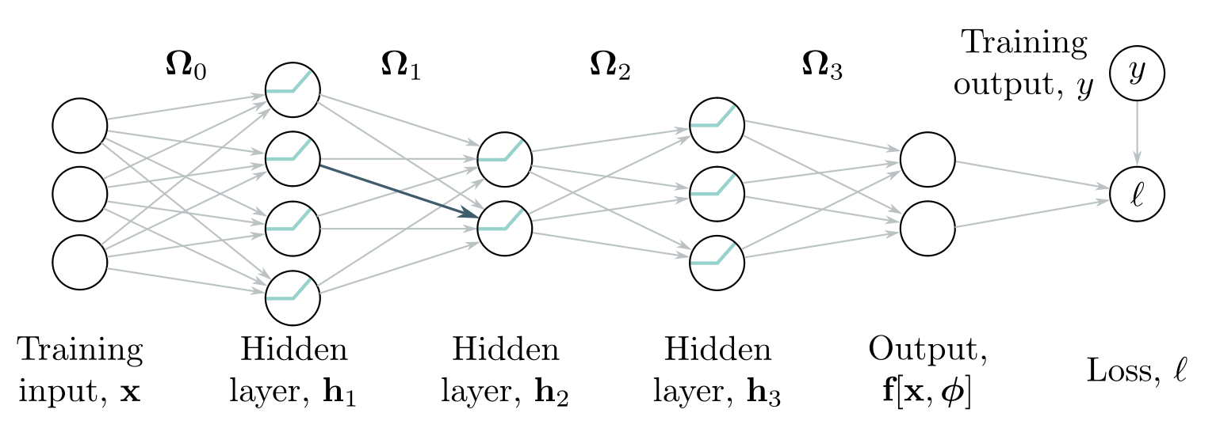
Backpropagation algorithm. Forward pass
Blue weight multiplies activation (ReLU output) in previous layer
We want to know how change in blue weight affects loss
If we double activation in previous layer, weight will have twice the effect
Conclusion: we need to know the activations at each layer.

Slide 45
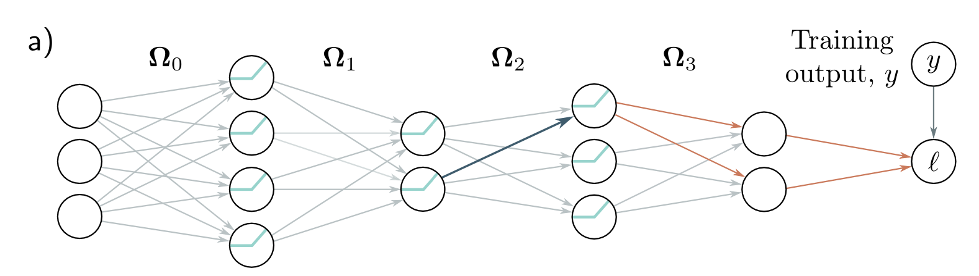
Backpropagation algorithm. Backward pass
To compute how a small change in a weight feeding into h₃ modifies the loss, we need:
How h₃ changes the model output
How the output changes the loss

Slide 46
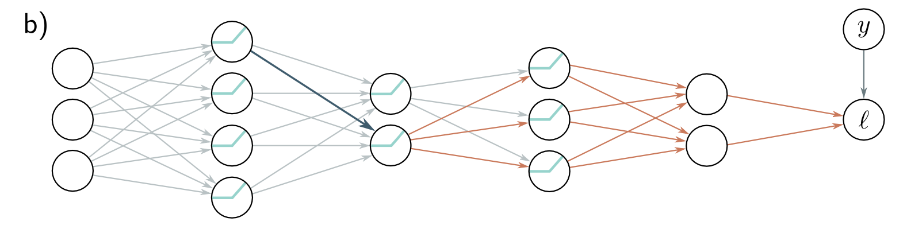
Backpropagation algorithm. Backward pass
To compute how a small change in a weight feeding into h₂ modifies the loss, we need:
How a change in layer h₂ affects h₃
How h₃ changes the model output
How the output changes the loss

Slide 47
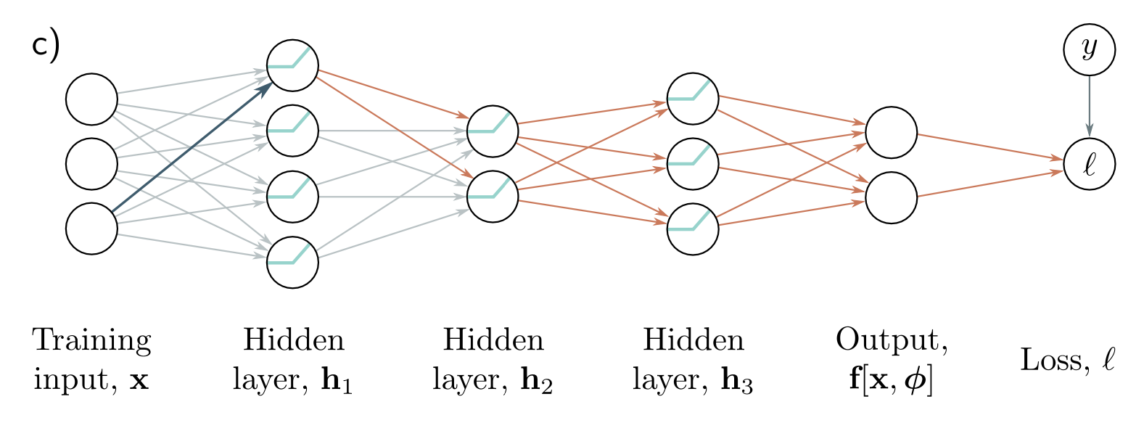
Backpropagation algorithm. Backward pass
To compute how a small change in a weight feeding into h₂ modifies the loss, we need:
How a change in layer h₁ affects h₂
How a change in layer h₂ affects h₃
How h₃ changes the model output
How the output changes the loss

Slide 48
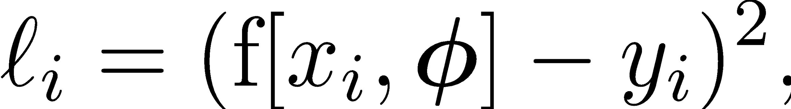
Toy example
A series of functions composed with each other
Unlike in neural networks it consists of scalars and not vectors and matrices
The “activation functions” are just sin, exp, cos

Slide 49
Toy example
Derivatives of the activation functions

Slide 50
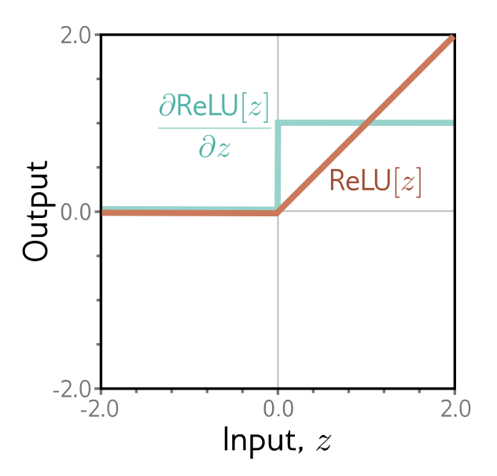
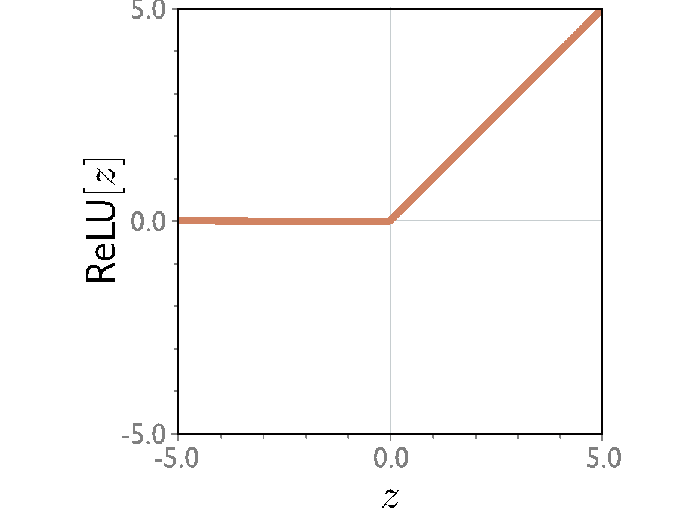
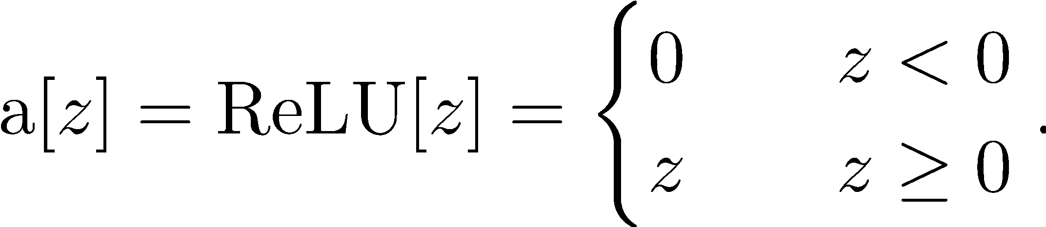
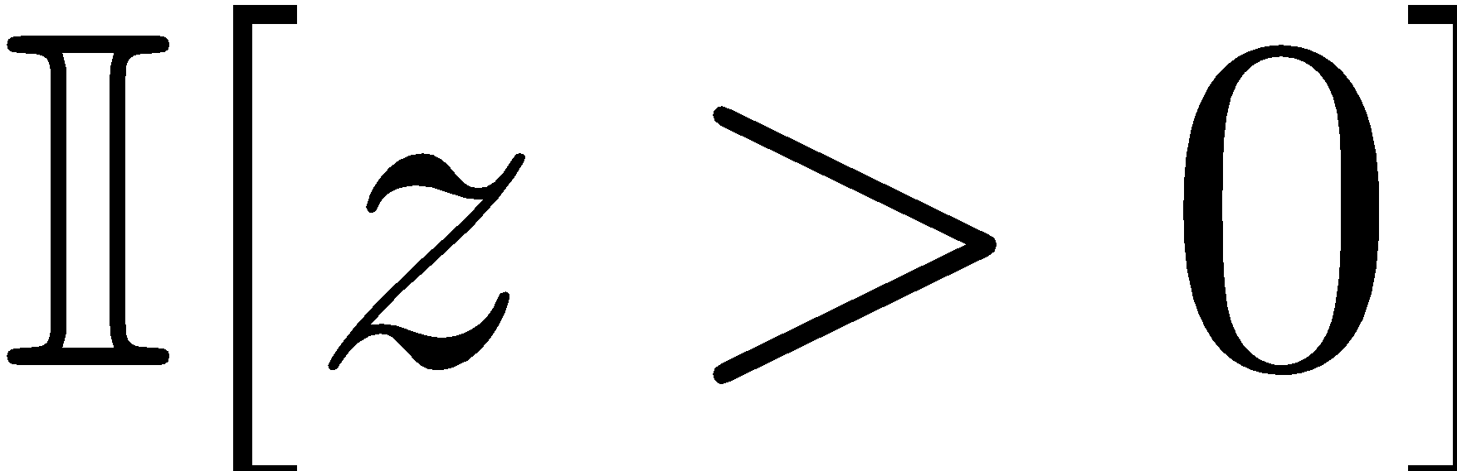
Warmup! Derivative of ReLU
?
Rectified Linear Unit

Slide 51
Toy example
How does a small change in 𝛽₂ change the loss ℓ_{i} for the i’th example?
We want to compute:

Slide 52
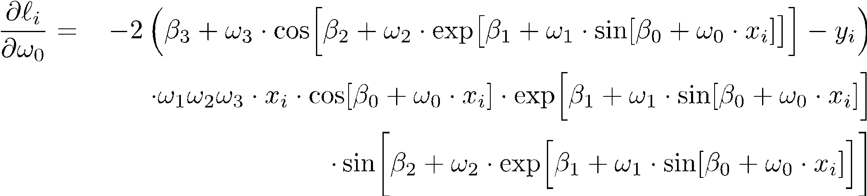
Gradients of composed functions
Calculating expressions by hand:
Some expressions are very complicated
There are some redundancies

Slide 53

Forward pass
1. Write this a series of intermediate calculations
2. Compute these intermediate quantities

Slide 54
Backward pass
1. Compute the derivatives of the loss with respect to these intermediate quantities, in reverse order.

Slide 55

Backward pass
1. Compute the derivatives of the loss with respect to these intermediate quantities, in reverse order.
The first are easy:

Slide 56

Backward pass
1. Compute the derivatives of the loss with respect to these intermediate quantities, in reverse order.
The rest are computed using the chain rule.
How does a small change in f₃ change ℓ_{i}?
How does a small change in h₃ change ℓ_{i}?
How does a small change in h₃ change f₃?

Slide 57
Backward pass
1. Compute the derivatives of the loss with respect to these intermediate quantities, in reverse order.
The rest are computed using the chain rule.
?
Already computed!
How does a small change in h₃ change ℓ_{i}?
𝑤₃

Slide 58

Backward pass
1. Compute the derivatives of the loss with respect to these intermediate quantities, in reverse order.
The rest are computed using the chain rule.
?
Already computed!
-sin(h₂)

Slide 59

Backward pass
1. Compute the derivatives of the loss with respect to these intermediate quantities, in reverse order.
The rest are computed using the chain rule.

Slide 60
Backward pass
1. Compute the derivatives of the loss with respect to these intermediate quantities, in reverse order.
The rest are computed using the chain rule.

Slide 61
Backward pass
1. Compute the derivatives of the loss with respect to these intermediate quantities, in reverse order.
The rest are computed using the chain rule.

Slide 62
Backward pass
1. Compute the derivatives of the loss with respect to these intermediate quantities, in reverse order.
Chain rule all the way down!

Slide 63

Backward pass
2. Find how the loss changes as a function of the parameters β and ω.
Chain rule all the way down! Same recipe for weight and bias terms too!

Slide 64

Backward pass
2. Find how the loss changes as a function of the parameters β and ω.
Chain rule all the way down! Same recipe for weight and bias terms too!

Slide 65
Reading suggestion
Check 7.4 in your textbook for a discussion on the extension to matrix calculus.

Slide 66
Automatic differentiation
Modern deep learning frameworks compute derivatives automatically
You just have to specify the model and the loss
How?
Each component knows how to compute its own derivative
ReLU knows how to compute deriv of output w.r.t. input
Linear function knows how to compute deriv of output w.r.t. input
Linear function knows how to compute deriv of output w.r.t. parameter
You specify the order of the components
It can compute the chain of derivatives
Works with branches as long as it’s still an acyclic graph

Slide 67
Optimisation

Slide 68
Training a simple model
Define a loss function
Compute the change in parameters required to make the loss smaller
Apply the change and get new parameters
Repeat from (2)

Slide 69


Gradient descent
Step 1: Compute derivatives (slopes of function) with
Respect to the parameters

Slide 70

Gradient descent
Step 1: Compute derivatives (slopes of function) with
Respect to the parameters

Slide 71

Gradient descent
Step 1: Compute derivatives (slopes of function) with
Respect to the parameters

Slide 72

Gradient descent
Step 1: Compute derivatives (slopes of function) with
Respect to the parameters

Slide 73



Gradient descent
Step 1: Compute derivatives (slopes of function) with
Respect to the parameters
Step 2: Update parameters according to rule

Slide 74


Gradient descent
Step 1: Compute derivatives (slopes of function) with
Respect to the parameters
Step 2: Update parameters according to rule

Slide 75

Gradient descent

Slide 76

Gradient descent
Step 1: Compute derivatives (slopes of function) with
Respect to the parameters
Step 2: Update parameters according to rule

Slide 77

Gradient descent
Step 1: Compute derivatives (slopes of function) with
Respect to the parameters
Step 2: Update parameters according to rule

Slide 78

Gradient descent

Slide 79

Gradient descent

Slide 80
Gradient descent

Slide 81
Line search
Step 1: Compute derivatives (slopes of function) with
Respect to the parameters
Step 2: Update parameters according to rule

Slide 82


Non-convex case. Gabor model

Slide 83



Gabor model

Slide 84


Slide 85

Gradient descent gets to the global minimum if we start in the right “valley”
Otherwise, descent to a local minimum
Or get stuck near a saddle point

Slide 86
Solution: add noise!
Stochastic gradient descent
Compute gradient based on only a subset of points – a mini-batch
Work through dataset sampling without replacement
One pass though the data is called an epoch

Slide 87




Slide 89


Slide 90
Properties of SGD
Can escape from local minima
Adds noise, but still sensible updates as based on part of data
Uses all data equally
Less computationally expensive
Seems to find better solutions
Doesn’t converge in traditional sense
Learning rate schedule – decrease learning rate over time

Slide 91

Momentum
Goh, Why momentum really works

Slide 92

Momentum
Weighted sum of this gradient and previous gradient

Slide 93


Slide 94

Adaptive moment estimation. Adam

Slide 95


Normalized gradients
Measure mean and pointwise squared gradient
Normalize:

Slide 96



Normalized gradients
Measure mean and pointwise squared gradient
Normalize:

Slide 97
Normalized gradients
Measure mean and pointwise squared gradient
Normalize:

Slide 98



Normalized gradients
Compute mean and pointwise squared gradients with momentum
Moderate near start of the sequence
Update the parameters

Slide 99
Adaptive moment estimation. Adam

Slide 100

RMSprop (precursor to Adam)
Compute mean and pointwise squared gradients with momentum
Update the parameters

Slide 101
How to reach me:
florin.gogianu@gmail.com
Please send unstructured feedback, since this is a new version of the lecture!

Slide 102
Post-lecture reading suggestions
Maximum Likelihood Estimation:
Prince, UDL book, ch. 5 to 5.5
Deisenroth, Mathematics for deep learning, ch. 8, 9
Bishop, Pattern recognition and machine learning, ch. 1.2.5, 1.2.6, 3.1, 3.3 and 4.3
Gradient checkpointing:
I actually believe the first google result is a good resource :), especially if you check the papers linked at the bottom of the post.
Ensembling in the weight space, some good starting points:
Izmailov, Averaging weights leads to wider optima and better generalization
Wortsman, Learning neural network subspaces

